Slide 1
Tool upload
Log in then on title pane click on New project to set up a new project

Slide 2
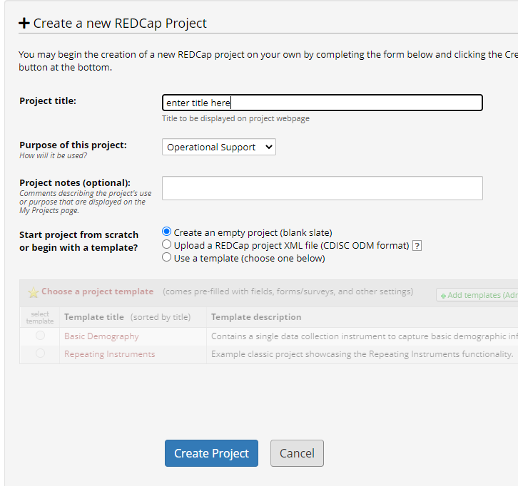
Specify title, choose operational support for purpose and blank slate as shown and click create new project which takes you to project setup

Slide 3
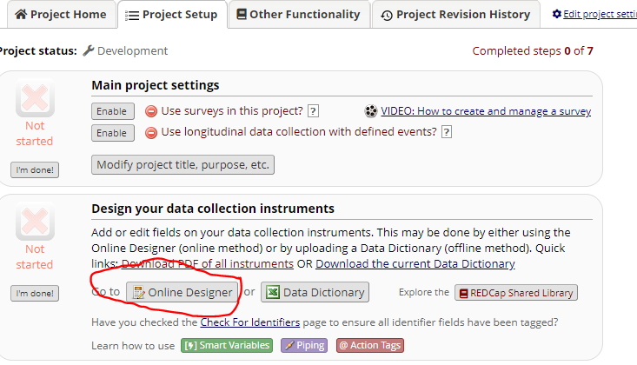
Tool upload
Under project setup, click online designer

Slide 4
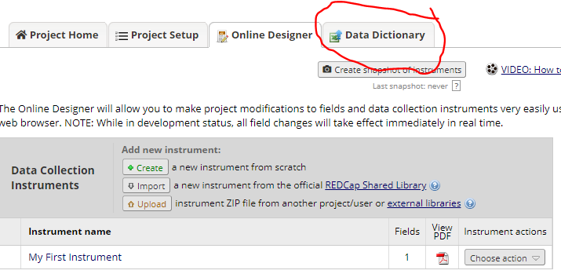
Tool upload
Then click data dictionary tab

Slide 5
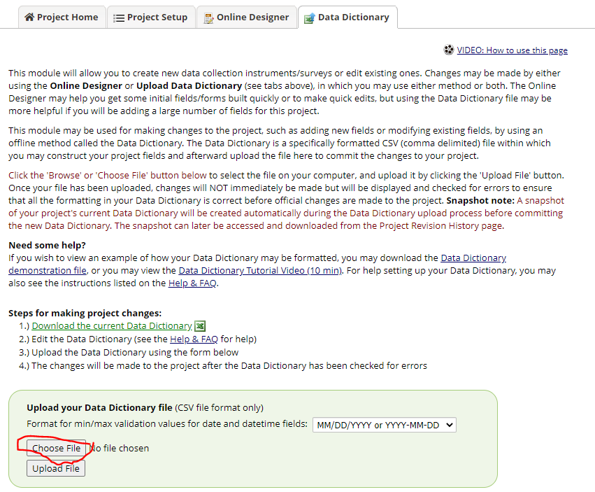
Click choose file and browse to location of the data dictionary.
Once selected click upload

Slide 6
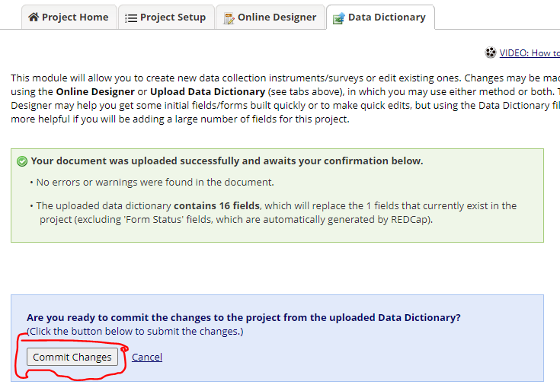
Click commit changes

Slide 7
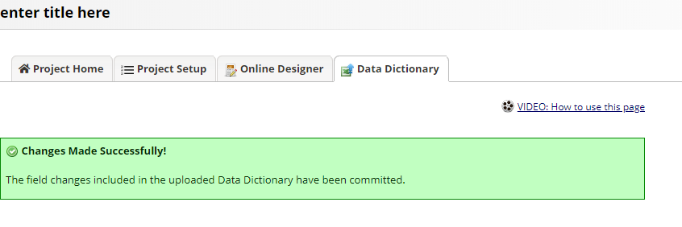
Changes made successfully

Slide 8
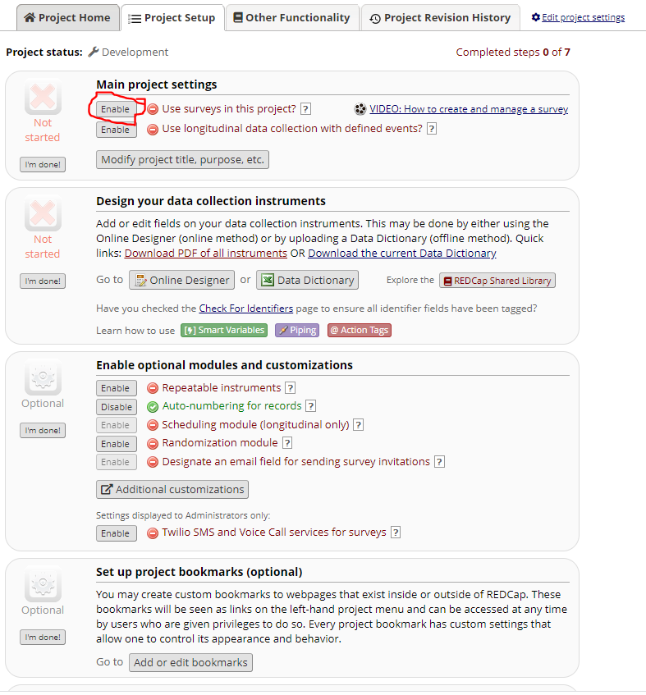
You need to update project settings
Click the project setup tab again
If it is survey, enable survey capabilities shown

Slide 9
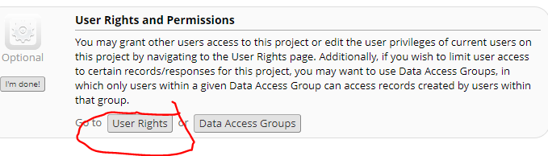
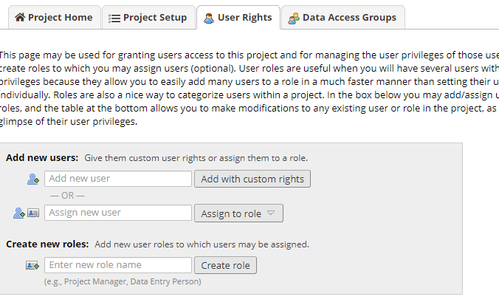
Update user rights
Add and assign rights accordingly

Slide 10
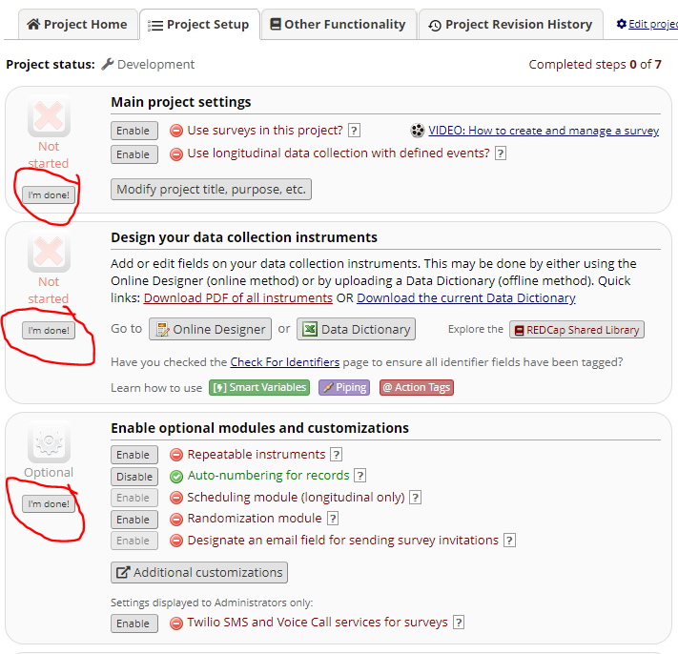
Once done with particular setting, click I’m done

Slide 11
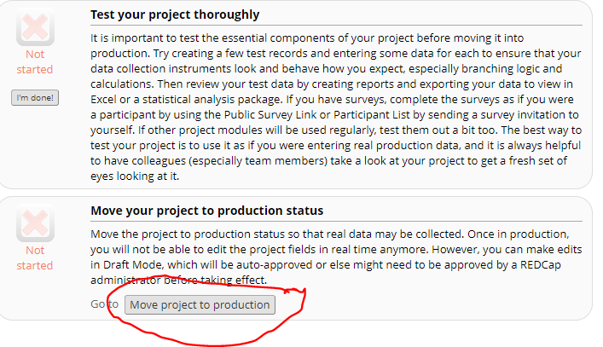
Test your project thoroughly and move to production if everything works as expected

Slide 12
Congratulations !!!
You just created your first blank slate Redcap project

